Slide 1
UNIT 1 INTRODUCTION TO STATISTICS

Slide 2
ORIGIN
The word statistics as been derived from:
The Latin Word : “status”
The Italian Word : “statista”
The German Word : “statistic”
Each of these words means a “political state”.

Slide 3
MEANING
Statistics is used in two ways
PLURAL SENSE
SINGULAR SENSE
DESCRIPTIVE STATISTICS
INFRENTIAL STATISTICS

Slide 4
DESCRIPTIVE V/S INFERENTIAL
DESCRIPTIVE STATISTICS : It includes the procedure for collecting , classifying, summarizing and presenting data.
It enables us to evaluate critically the information presented in reports, articles , etc.
INFERENTIAL STATISTICS : It not only describes the important features of the data but also allows to proceed beyond data collection into the area of decision making through generalizations and predictions.

Slide 5
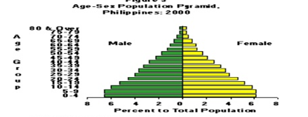
EXAMPLE OF DESCRIPTIVE STATISTICS
The Philippine population by constructing a graph indicating the total number of Filipinos counted during the last census by age group and gender

Slide 6

EXAMPLE OF INFERENTIAL STATISTICS
A new milk formulation designed to improve the psychomotor development of infants was tested on randomly selected infants.
Based on the results, it was concluded that the new milk formulation is effective in improving the psychomotor development of infants.

Slide 7
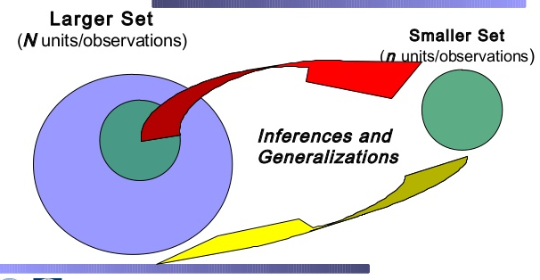
INFERENTIAL STATISTICS

Slide 8
DEFINITIONS
plural sense: numerical facts, e.g. CPI, rupee-dollar exchange rate
singular sense: scientific discipline consisting of theory and methods for processing numerical information that one can use when making decisions in the face of uncertainty.

Slide 9
DEFINITIONS
Statistics may be defined as the science of collection, presentation, analysis and interpretation of numerical data.
- Croxton and Cowden
Statistics is the science of estimates and probabilities.
- Boddington
Statistics may be called the science of counting and averages.
- Bowley

Slide 10
CHARACTERISTICS
Statistics are aggregate of Facts : A single fact or figure cannot be called statistics.
Statistics are expressed numerically : Statistics is the study of those facts which can be expressed numerically.
Statistics must be placed in relation to each other: The statistical data which is collected must be comparable with each other.
Statistics are collected for a pre- determined purpose : The purpose and objective of collecting the data must be clearly defined.

Slide 11
NATURE
IS STATISTICS A SCIENCE OR AN ART OR BOTH ?
Science refers to a systematized body of knowledge, it studies causes and effect relationship to find out generalizations.
Cowden defined, “statistics as the science of collection, presentation, analysis and interpretation of numerical data”.
Art is that branch of knowledge which tells us the best possible methods so as to meet certain specifications.
According to Harlow, “Statistics is both a science and an art of handling aggregate of facts-observing, enumeration, recording, classifying and otherwise systematically treating them.

Slide 12
FUNCTIONS
PRECISENESS AND DEFINITENESS: Statistical techniques enable us to present facts in clear, precise and definite form.
CONDENSATION: With the help of statistical tools a mass of data can be condensed into a few presentable, understandable and significant figures.
COMPARISON: the absolute figure themselves do not convey any significant meaning. It is their comparison tat helps us to draw conclusions.
FORMULATION AND TESTING OF HYPOTHESIS: Establishes a relationship between two or more variables.
PREDICTION: Analyse past data and predict future trends
FORMULATION OF SUITABLE POLICIES: helps in formulation of various economic, business and other national policies.

Slide 13
USE OF STATISTICS
Statistics is one of the most powerful and indispensable tools in any specific enquiry which has found applications to a very large number of disciplines, such as:
Agriculture
Industry
Psychology
Ecology
Economics
Insurance
Business
Sociology
Biology

Slide 14
Statistics in Business, Commerce and Industry
Decision Making
Time Series Analysis
Analyze demand
Business Cycle Trend

Slide 15
Statistics in Economics
Economic Problems: unemployment, poverty, prices, income distribution
Statistical data and techniques
Economic Theories

Slide 16
Statistics in Science
Astronomy
Agriculture
Meteorology
Biology
Medicine

Slide 17
Statistics in Research
Development of New Techniques
Strategies
Theories

Slide 18
LIMITATIONS
Qualitative Aspect is Ignored: It needs conversion of qualitative data into quantitative data. Eg : Health, Stress, Beauty
It does not deal with individual items: statistics deals with only aggregates of facts or items and it does not recognize any individual item.
Eg: Expenditure incurred by a family in a month, average marks of BCA III in statistics.

Slide 19
It does not depict entire story of phenomenon : When ever a phenomena happen, that is due to many causes, but all these causes can not be expressed in terms of data. So we cannot reach at the correct conclusions.
Eg: Demand of Commodity
It is liable to be miscued : As W.I. King points out, “One of the short-comings of statistics is that do not bear on their face the label of their quality.”
Eg: Error in collecting data (bias)

Slide 20
Results are true only on average: “Statistics largely deals with averages and these averages may be made up of individual items radically different from each other.” —W.L King
Too Many methods to study problems:
In this subject we use so many methods to find a single result, which may cause variations in the results.

Slide 21
Statistical Interpretations require a high degree of skill and understanding of the subject.

Slide 22
Thank You..!

